Slide 1

Chapter 22
Next Generation
IP
Copyright © The McGraw-Hill Companies, Inc. Permission required for reproduction or display.
Notes:
1

Slide 2
Chapter 22: Outline
22.1 IPv6 ADDRESSING
22.2 THE IPv6 PROTOCOL
22.3 THE ICMPv6 PROTOCOL
22.4 TRANSITION FROM IPv4 TO IPv6
Notes:
22.#

Slide 3

Chapter 22: Objective
The first section discusses the addressing mechanism in the new generation of the Internet. The section first describes the representation and address space. It then shows the allocation in the address space. The section finally explains auto-configuration and renumbering, which makes it easy for a host to move from one network to another.
The second section discusses IPv6 protocol. First the new packet format is described. The section then shows how use of extension headers can replace the options.
Notes:
22.#

Slide 4
Chapter 22: Objective (continued)
The third section discusses ICMPv6. The section describes how the new protocol replaces several auxiliary protocols in version 4. The section also divides the messages in this protocol into four categories and describes them.
The fourth section briefly shows how transition can be made from the current version to the new one smoothly. The section explains three strategies that need to be followed for this smooth transition.
Notes:
22.#

Slide 5
22-1 IPv6 Addressing
The main reason for migration from IPv4 to IPv6 is the small size of the address space in IPv4. In this section, we show how the huge address space of IPv6 prevents address depletion in the future. We also discuss how the new addressing responds to some problems in the IPv4 addressing mechanism. An IPv6 address is 128 bits or 16 bytes (octets) long, four times the address length in IPv4.
22.5
Notes:
22.#

Slide 6
22.22.1 Representation
A computer normally stores the address in binary, but it is clear that 128 bits cannot easily be handled by humans. Several notations have been proposed to represent IPv6 addresses when they are handled by humans. The following shows two of these notations: binary and colon hexadecimal.
22.6
Notes:
22.#

Slide 7
22.22.2 Address Space
The address space of IPv6 contains 2¹²⁸ addresses. This address space is 2⁹⁶ times the IPv4 address—definitely no address depletion—as shown, the size of the space is
22.7
Notes:
22.#

Slide 8
22.22.3 Address Space Allocation
Like the address space of IPv4, the address space of IPv6 is divided into several blocks of varying size and each block is allocated for a special purpose. Most of the blocks are still unassigned and have been set aside for future use. Table 22.1 shows only the assigned blocks. In this table, the last column shows the fraction each block occupies in the whole address space..
22.8
Notes:
22.#

Slide 9

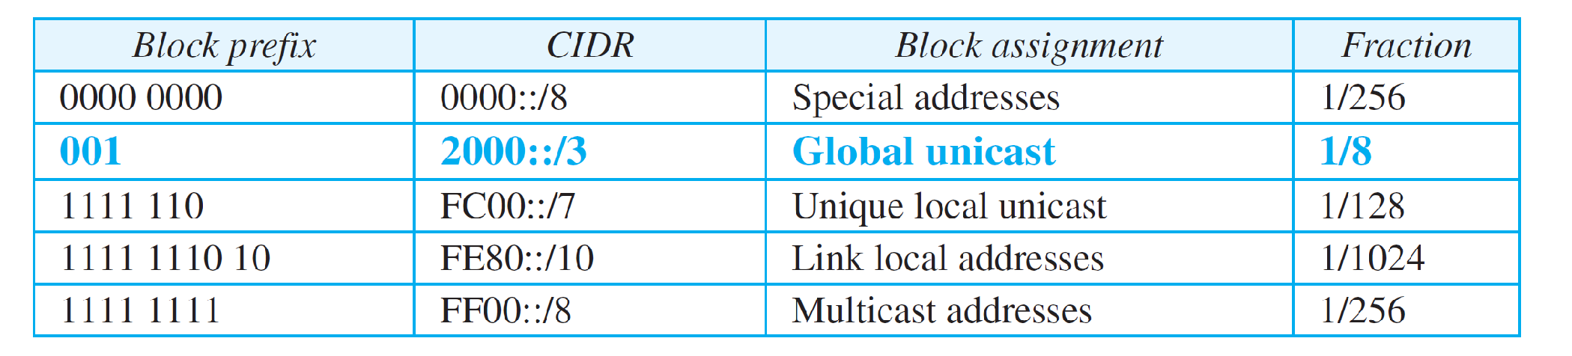
Table 22.1: Prefixes for assigned IPv6 addresses
22.9
Notes:
9

Slide 10
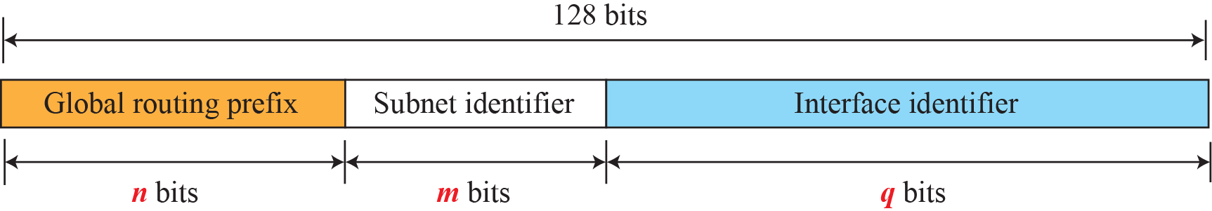

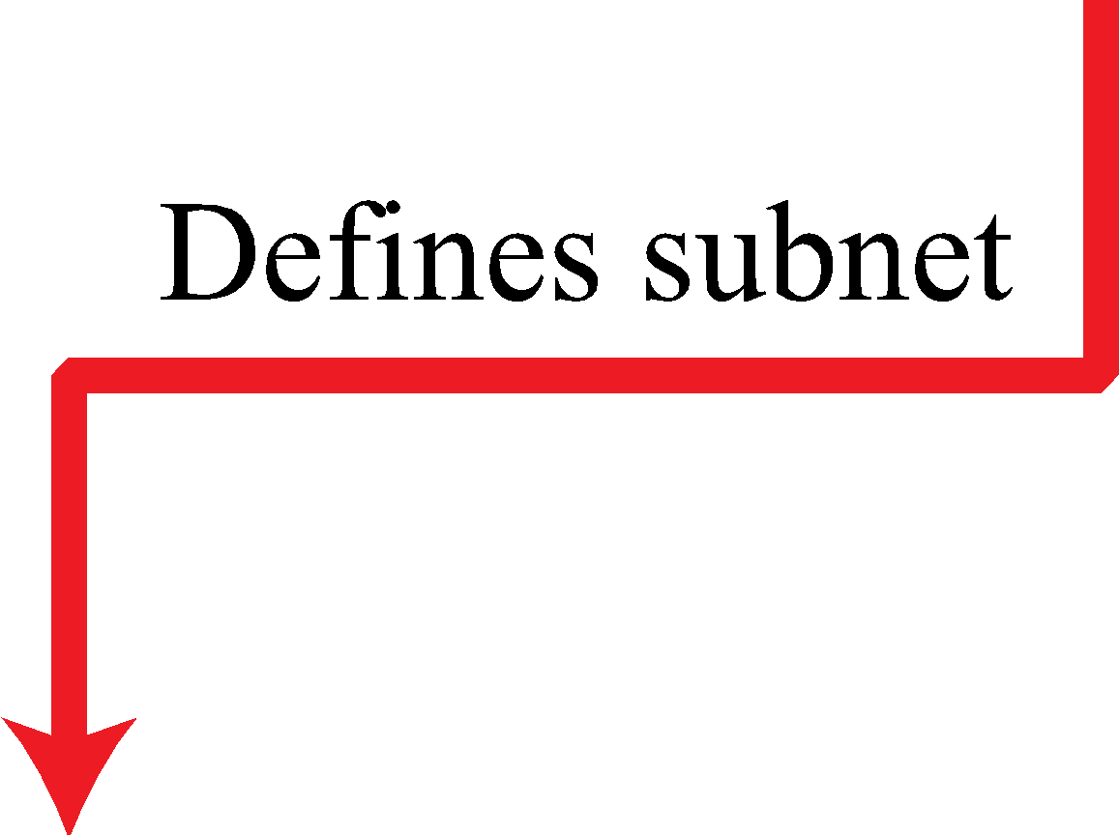
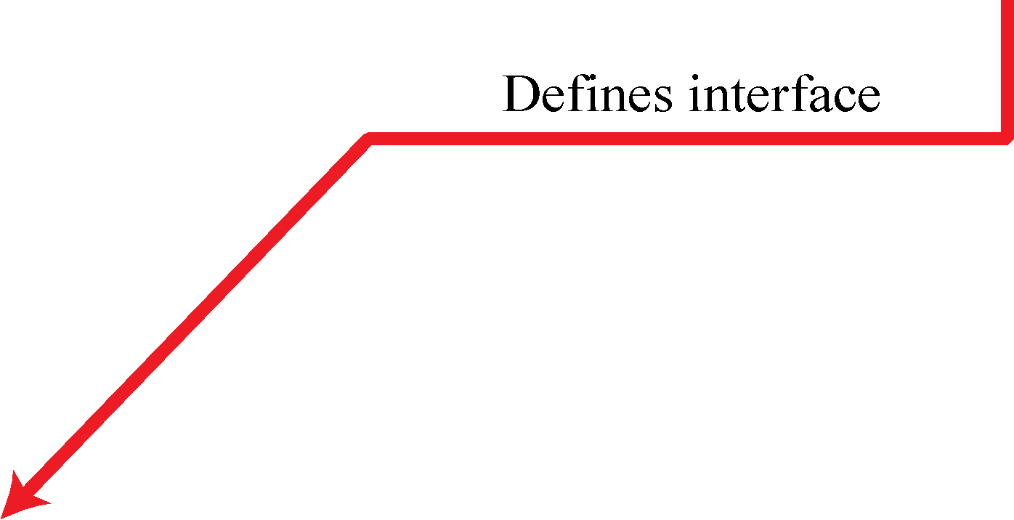
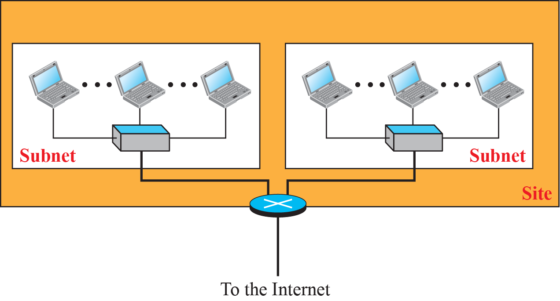
Figure 22.1: Global unicast address
48 16 64
22.10
Notes:
22.#

Slide 11
Figure 22.2: Mapping for EUI-64
22.11
Notes:
22.#

Slide 12
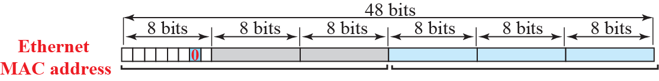

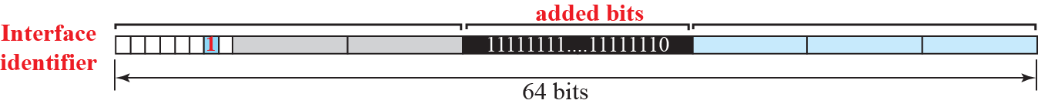
Figure 22.3: Mapping for Ethernet MAC
22.12
Notes:
22.#

Slide 13
Example 22.1
An organization is assigned the block 2000:1456:2474/48. What is the CIDR notation for the blocks in the first and second subnets in this organization?
Solution
Theoretically, the first and second subnets should use the blocks with subnet identifier 0001₁₆ and 0002₁₆. This means that the blocks are 2000:1456:2474:0000/64 and 2000:1456:2474:0001/64.
22.13
Notes:
13

Slide 14
Example 22.2
Using the format we defined for Ethernet addresses, find the interface identifier if the physical address in the EUI is (F5-A9-23-EF-07-14-7A-D2)₁₆.
11110101
11110111->F7 In Interface identifier 7th bit is 1
Solution
We only need to change the seventh bit of the first octet from 0 to 1 and change the format to colon hex notation. The result is F7A9:23EF:0714:7AD2.
22.14
Notes:
14

Slide 15
Example 22.3
Using the format we defined for Ethernet addresses, find the interface identifier if the Ethernet physical address is (F5-A9-23-14-7A-D2)16.
Ethernet to interface:- Change 7th bit to 1 Add FFFE in 25th bit
Solution
We only need to change the seventh bit of the first octet from 0 to 1, insert two octets FFFE₁₆ and change the format to colon hex notation. The result is F7A9:23FF:FE14:7AD2 in colon hex.
22.15
Notes:
15

Slide 16
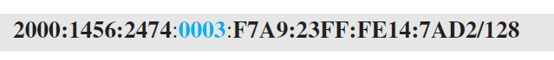
Example 22.4
An organization is assigned the block 2000:1456:2474/48. What is the IPv6 address of an interface in the third subnet if the IEEE physical address of the computer is
(F5-A9-23-14-7A-D2)16?
Solution
The interface identifier for this interface is F7A9:23FF:FE14:7AD2 (see Example 22.3). If we append this identifier to the global prefix and the subnet identifier, we get:
22.16
Notes:
16

Slide 17
Figure 22.4: Special addresses
22.17
Notes:
22.#

Slide 18
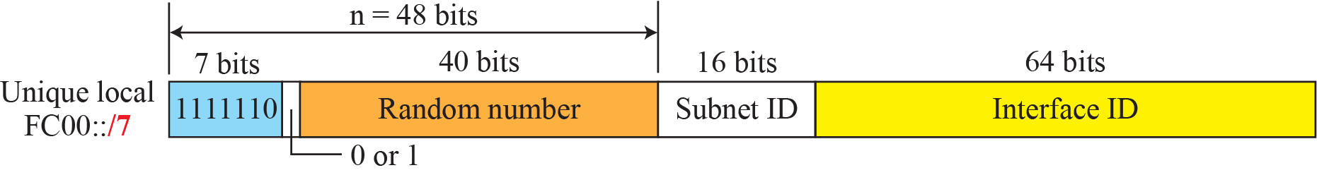
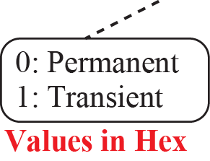
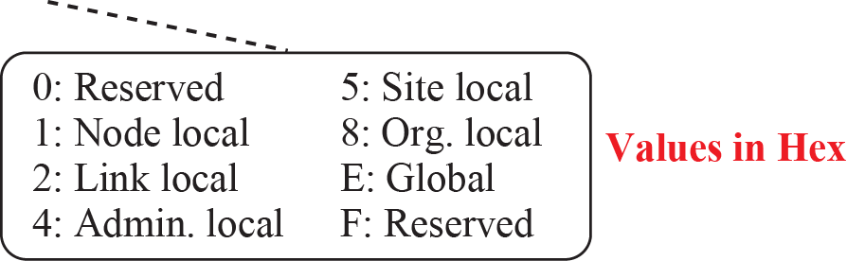
Figure 22.5: Unique local unicast block
22.18
Notes:
22.#

Slide 19
22.22.4 Autoconfiguration
One of the interesting features of IPv6 addressing is the auto-configuration of hosts. As we discussed in IPv4, the host and routers are originally configured manually by the network manager. However, the Dynamic Host Configuration Protocol, DHCP, can be used to allocate an IPv4 address to a host that joins the network. In IPv6, DHCP protocol can still be used to allocate an IPv6 address to a host, but a host can also configure itself.
22.19
Notes:
22.#

Slide 20
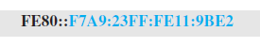
Example 22.5
Assume a host with Ethernet address
(F5-A9-23-11-9B-E2)¹⁶
has joined the network. What would be its global unicast address if the global unicast prefix of the organization is
3A21:1216:2165 and the subnet identifier is A245:1232?
Solution
The host first creates its interface identifier as F7A9:23FF:FE11:9BE2 using the Ethernet address read from its card. The host then creates its link local address as:
22.20
Notes:
20

Slide 21
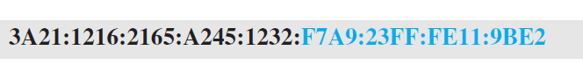
Example 22.5 (Conintued)
Assuming that this address is unique, the host sends a router solicitation message and receives the router advertisement message that announces the combination of global unicast prefix and the subnet identifier as 3A21:1216:2165:A245:1232. The host then appends its interface identifier to this prefix to find and store its global unicast address as:
22.21
Notes:
21

Slide 22
22.22.5 Renumbering
To allow sites to change the service provider, renumbering of the address prefix (n) was built into IPv6 addressing. As we discussed before, each site is given a prefix by the service provider to which it is connected. If the site changes the provider, the address prefix needs to be changed. A router to which the site is connected can advertise a new prefix and let the site use the old prefix for a short time before disabling it. In other words, during the transition period, a site has two prefixes.
22.22
Notes:
22.#

Slide 23
22-2 THE IPv6 PROTOCOL
The change of the IPv6 address size requires the change in the IPv4 packet format. The designer of IPv6 decided to implement remedies for other shortcomings now that a change is inevitable. The following shows other changes implemented in the protocol in addition to changing address size and format.
22.23
Notes:
22.#

Slide 24
22.2.1 Packet Format
The IPv6 packet is shown in Figure 22.6. Each packet is composed of a base header followed by the payload. The base header occupies 40 bytes, whereas payload can be up to 65,535 bytes of information. The description of fields follows.
22.24
Notes:
22.#

Slide 25
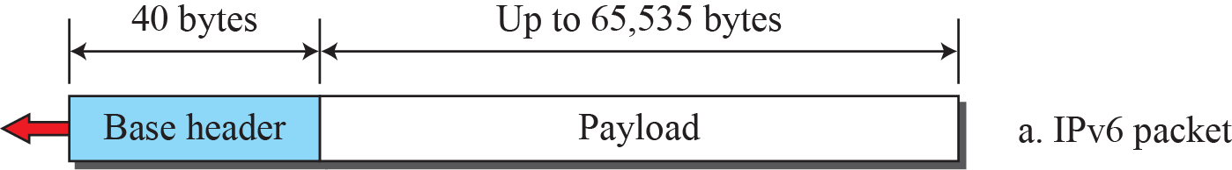
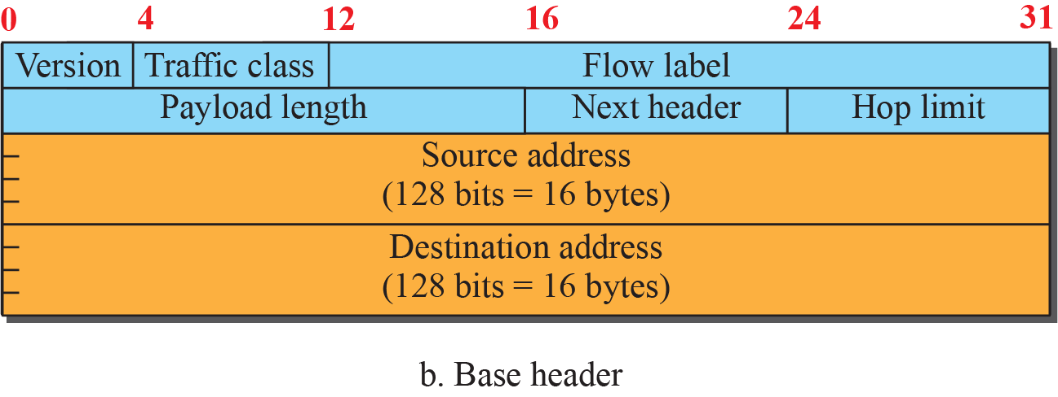
Figure 22.6: IPv6 datagram
Particular
Packet is
Flow of
Particular
label
22.25
Notes:
22.#

Slide 26
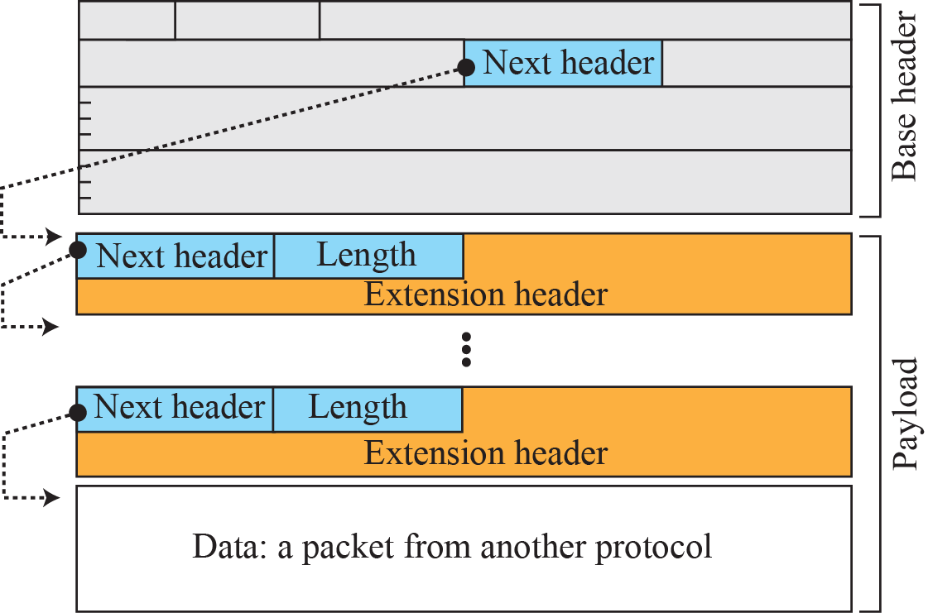
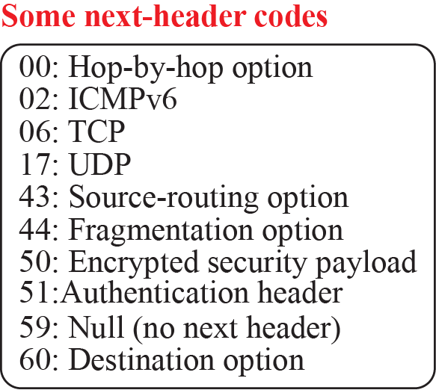
Figure 22.7: Payload in an IPv6 datagram
22.26
Notes:
22.#

Slide 27
22.2.2 Extension Header
An IPv6 packet is made of a base header and some extension headers. The length of the base header is fixed at 40 bytes. However, to give more functionality to the IP datagram, the base header can be followed by up to six extension headers. Many of these headers are options in IPv4. Six types of extension headers have been defined. These are hop-by-hop option, source routing, fragmentation, authentication, encrypted security payload, and destination option (see Figure 22.8).
22.27
Notes:
22.#

Slide 28
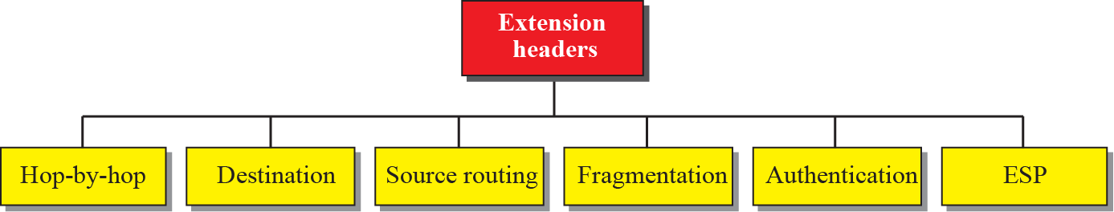
Figure 22.8: Extension Header Types
22.28
Notes:
22.#

Slide 29
22-3 THE ICMPv6 PROTOCOL
Another protocol that has been modified in version 6 of the TCP/IP protocol suite is ICMP. This new version, ICMPv6, follows the same strategy and purposes of version 4. ICMPv6, however, is more complicated than ICMPv4: some protocols that were independent in version 4 are now part of ICMPv6 and some new messages have been added to make it more useful.
22.29
Notes:
22.#

Slide 30
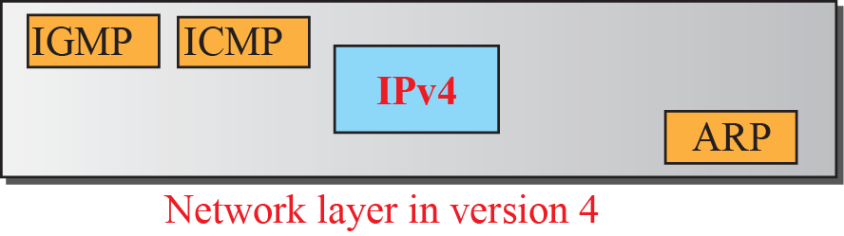
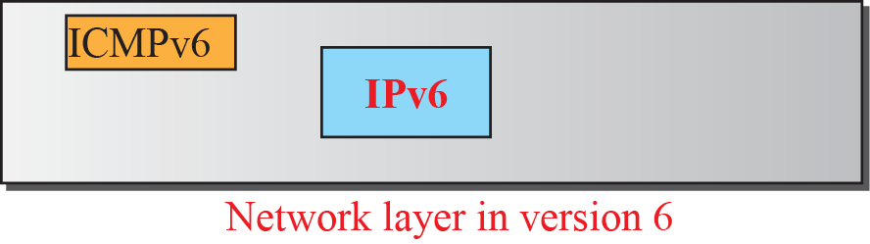
Figure 22.9: Comparison of network layer in version 4 and version 6
22.30
Notes:
22.#

Slide 31
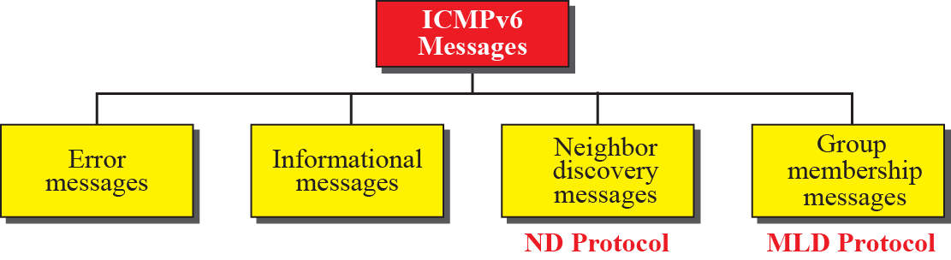
Figure 22.10: Categories of ICMPv6 messages
22.31
Notes:
22.#

Slide 32
22.3.1 Error-Reporting Messages
As we saw in our discussion of version 4, one of the main responsibilities of ICMPv6 is to report errors. Four types of errors are handled: destination unreachable, packet too big, time exceeded, and parameter problems. Note that the source-quenched message, which is used to control congestion in version 4, is eliminated in this version because the priority and flow label fields in IPv6 are supposed to take care of congestion.
22.32
Notes:
22.#

Slide 33
22.3.2 Informational Messages
Two of the ICMPv6 messages can be categorized as informational messages: echo request and echo reply messages. The echo-request and echo-reply messages are designed to check whether two devices in the Internet can communicate with each other. A host or router can send an echo-request message to another host; the receiving computer or router can reply using the echo-reply message.
22.33
Notes:
22.#

Slide 34
22.3.3 Neighbor-Discovery Messages
Several messages in ICMPv4 have been redefined in ICMPv6 to handle the issue of neighbor discovery. Some new messages have also been added to provide extension. The most important issue is the definition of two new protocols that clearly define the functionality of these group messages: the Neighbor-Discovery (ND) protocol and the Inverse-Neighbor-Discovery (IND) protocol.
22.34
Notes:
22.#

Slide 35
22.3.4 Group Membership Messages
The management of multicast delivery handling in IPv4 is given to the IGMPv3 protocol. In IPv6, this responsibility is given to the Multicast Listener Delivery protocol. MLDv1 is the counterpart to IGMPv2; MLDv2 is the counterpart to IGMPv3. The
material discussed in this section is taken from RFC 3810. The idea is the same as we discussed in IGMPv3, but the sizes and formats of the messages have been changed to fit the larger multicast address size in IPv6. Like IGMPv3, MLDv2 has two types of messages: membership-query message and membership-report message.
22.35
Notes:
22.#

Slide 36
22-4 TRANSITION FROM IPv4 TO IPv6
Although we have a new version of the IP protocol, how can we make the transition to stop using IPv4 and start using IPv6? in the Internet can move The transition must be smooth to prevent any problems between IPv4 and IPv6 systems.
22.36
Notes:
22.#

Slide 37
22.4.1 Strategies
Three strategies have been devised for transition: dual stack, tunneling, and header translation. One or all of these three strategies can be implemented during the transition
period..
22.37
Notes:
22.#

Slide 38
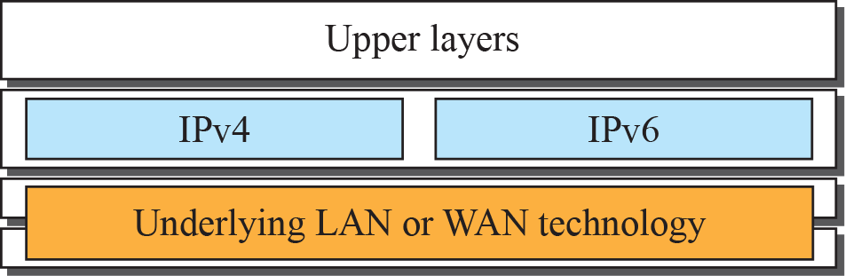


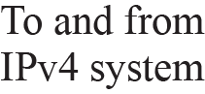
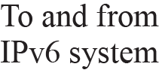
Figure 22.11: Dual stack
22.38
Notes:
22.#

Slide 39
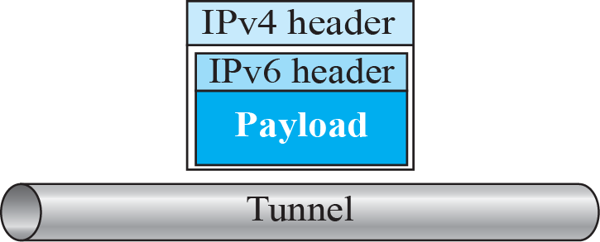
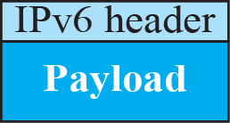
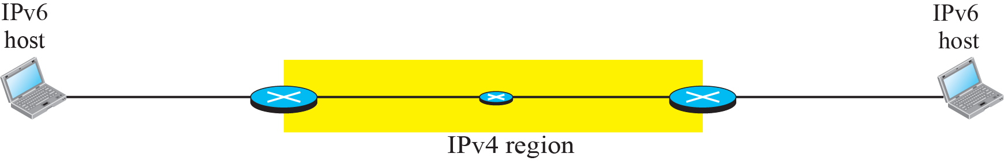
Figure 22.12: Tunneling strategy
22.39
Notes:
22.#

Slide 40
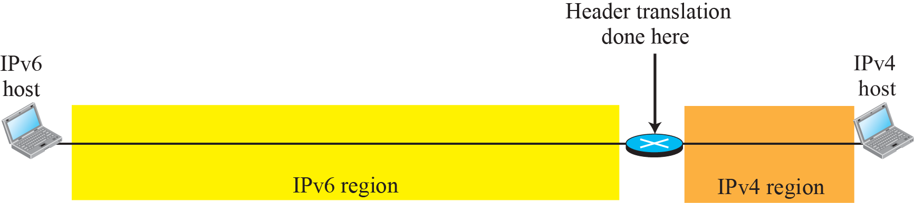
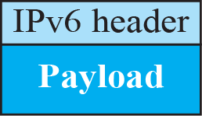
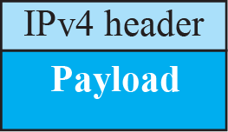
Figure 22.13: Header translation strategy
22.40
Notes:
22.#

Slide 41
22.4.2 Use of IP Addresses
During the transition a host may need to use two addresses, IPv4 and IPv6. When the transition is complete, IPv4 addresses should disappear. The DNS servers (see Chapter 26) need to be ready to map a host name to either address type during the transition, but the IPv4 directory will disappear after all hosts in the world have migrated to IPv6.
22.41
Notes:
22.#

